Slide 1

POTTI SRIRAMULU CHALAVADI MALLIKARJUNA RAO
COLLEGE OF ENGINEERING AND TECHNOLOGY
DEPARTMENT OF ELECTRONICS AND COMMUNICATION ENGINEERING
Efficient Approximate Adders with Minimal Error for FPGA Implementation
by
Shanmukha Poorna chand (21KT5A0410)
K. Keerthi (21KT5A0419)
B. Avinash (20KT1A04D7)
Md. Ahmed Ashraf (20KT1A04F7)
Under the Esteemed Guidance of Mr. K. Raghavendra Rao
Assistant professor
PSCMR College of Engineering & Technology

Slide 2
Efficient Approximate Adders with Minimal Error for FPGA Implementation

Slide 3
Contents
Abstract
Introduction
Literature review
Existing Method
Proposed method
Conclusion
Future scope
References

Slide 4
Abstract
In this project, a methodology for designing low error efficient approximate adders has been proposed. The proposed methodology utilizes FPGA resources efficiently to reduce the error of approximate adders. We propose two approximate adders for FPGAs using our methodology: low error and area efficient approximate adder (LEADx), and area and power efficient approximate adder (APEx). Both approximate adders are composed of an accurate and an approximate part.

Slide 5
The approximate parts of these adders are designed in a systematic way to minimize the mean square error (MSE). LEADx has lower MSE than the approximate adders in the literature. APEx has smaller area and lower power consumption than the other approximate adders than the existing adders. As a case study, the approximate adders are used in video encoding application. LEADx provided better quality than the other approximate adders for video encoding application. Therefore, our proposed approximate adders can be used for efficient FPGA implementations of error tolerant applications.

Slide 6
Introduction
Approximate adders can be broadly classified into the following categories:
Segmented adders, which divide n-bit adder into several r-bit adders operating in parallel
Speculative adders, which predict the carry using only the few previous bits
Approximate full-adder based adders, which approximate the accurate full-adder at transistor or gate level.
Segmented and speculative adders usually have higher speeds and larger areas than accurate adders.

Slide 7
Approximate full-adder based approximate n-bit adders use m-bit approximate adder in the least significant part (LSP) and (n − m)-bit accurate adder in the most significant part (MSP)
Approximate computing trades off accuracy to improve the area, power, and speed of digital hardware. Many computationally intensive applications such as video encoding, video processing, and artificial intelligence are error resilient by nature due to the limitations of human visual perception or nonexistence of a golden answer for the given problem.
Therefore, approximate computing can be used to improve the performance of digital hardware implementations of these error tolerant applications

Slide 8
Literature review
S. NO | Journal Type | Authors | Title | Outcomes
1 | IEEE Transaction(2019) | G. A. Gillani, M. A. Hanif, et al. | MACISH: Designing approximate MAC accelerators with internal-self-healing | In this, a more effective quality-efficiency trade-off offered by the ISH methodology as compared to the conventional approximate computing methodology.
2 | IEEE conference (2020) | E. Kalali and I. Hamzaoglu | An approximate HEVC intra angular prediction hardware | The proposed approximation technique causes negligible PSNR loss and bit rate increase. It significantly reduces area of the proposed approximate hardware by enabling efficient use of one MCM data-path to implement all constant multiplications using add and shift operations and by reducing amount of on-chip memory.

Slide 9
S. NO | Journal Type | Authors | Title | Outcomes
3 | IEEE transactions (2019) | T. Ayhan and M. Altun | Circuit aware approximate system design with case studies in image processing and neural networks | From this, we bring approximate circuit design methods and system analysis techniques together to implement quality scalable yet cost efficient systems.
4 | IEEE conference (2021) | W. Ahmad and I. Hamzaoglu | An efficient approximate sum of absolute differences hardware for FPGAs | From this area is optimized and resolution is reduced and increases the overall efficiency of the design

Slide 10
Existing method
In the existing method, an approximate adder LOA (lower-part OR adder) is designed. The lower-part OR adder (LOA) is an approximate adder design implemented using an approximate FA for the least significant bits (LSBs) of a multi-bit adder.
The LOA consists of two parts: an accurate part and an inaccurate part. The former part uses a traditional precise adder, such as the ripple carry adder (RCA) and carry-look-ahead adder (CLA), to calculate the most significant bits (MSBs) with no computation error.

Slide 11
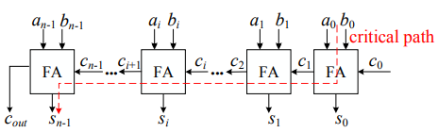
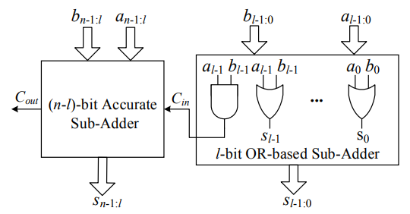
Whereas, the latter part only uses an OR operation to approximately obtain LSB summations. Furthermore, the output of an AND operation for the MSB input pair of the inaccurate part is utilized as a carry input to the accurate part.
The Half-Adder is a basic building block of adding two numbers as two inputs and produce out two outputs. The adder is used to perform OR operation of two single bit binary numbers
Fig: Accurate Adder
Fig: LO adder

Slide 12
A full adder is a logical circuit that performs an addition operation on three binary digits and just like the half adder, it also generates a carry out to the next addition column.
In many ways, the full adder can be thought of as two half adders connected together, with the first half adder passing its carry to the second half adder
A ripple carry adder is an important digital electronics concept, essential in designing digital circuits. Multiple full adder circuits can be cascaded in parallel to add an N-bit number. For an N- bit parallel adder, there must be N number of full adder circuits.

Slide 13
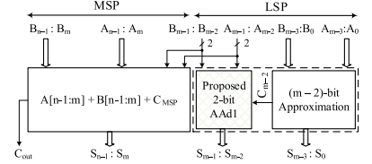
Proposed method
The proposed design methodology uses the approximate full adder based n-bit adder architecture shown in Fig. n-bit addition is divided into n-bit approximate adder in the LSP and (n−m)-bit accurate adder in the MSP.
Breaking the carry chain at bit-position m generally introduces an error of 2m in the final sum.
Fig: approx. adder

Slide 14
For an area efficient FPGA implementation, we propose to split the first m − 2 bits of LSP into d(m − 2)/2e groupsof 2-bit inputs such that each group is mapped to a single LUT.
Each group adds two 2-bit inputs with carry-in using an approximate 2-bit adder (AAd2). To eliminate the carry chain in LSP, we propose to equate Cout of ith group to one of the inputs of that group (Ai+1).
This results in error in 8 out of 32 possible cases with an absolute error magnitude of 4 in each erroneous case.
An n-bit LEADx uses [(m − 2)/2] copies of AAd2 adder in the least significant m − 2 bits of the approximate adder architecture. In LEADx, Cm−2 = Am−3.
AAd2 implements a 5-to-2 logic function that is mapped to a single LUT.

Slide 15
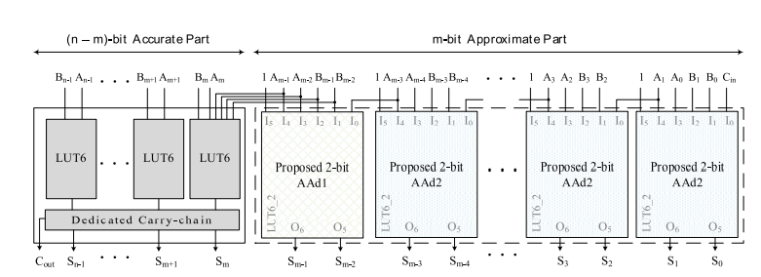
Fig: LEADx

Slide 16
APEx is also based on the approximate adder architecture shown in Fig. 4. For the least significant m − 2 bits of the LSP, the aim is to find an approximate function with no data dependency.
Carry should neither be generated nor used for sum computation. A 1-bit input pair at any bit position i ≤ (m − 2) should produce a 1-bit sum output only.
In general, any logic function with 1-bit output can be used as an approximate function to compute the approximate sum of 1-bit inputs at its bit position. A constant 0 or constant 1 at the output are also valid approximate functions.

Slide 17
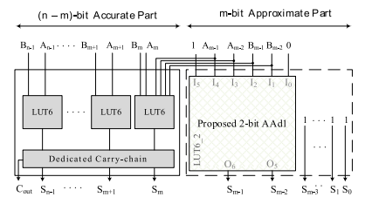
Fixing the output to 0 or 1 will reduce the area and power consumption of the approximate adder because no hardware will be required for sum computation.
FIG: APEx

Slide 18
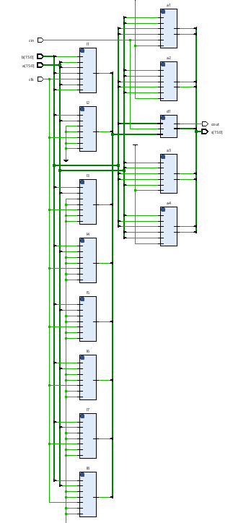
Results
RTL Schematic of LEADx

Slide 19
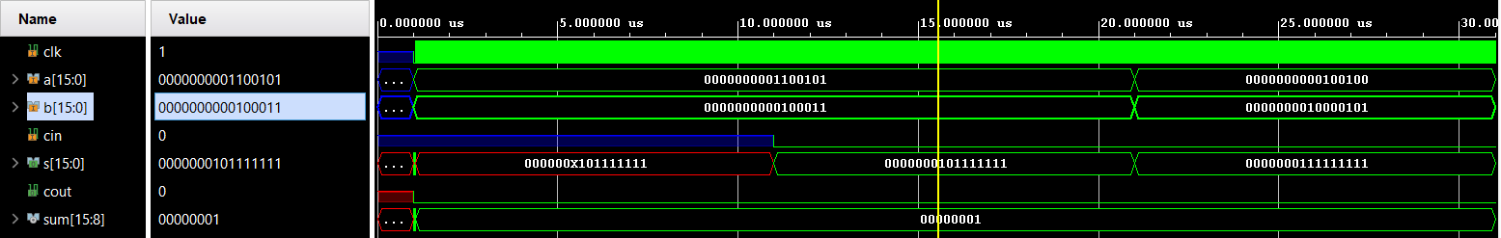
Simulation results of LEADx

Slide 20
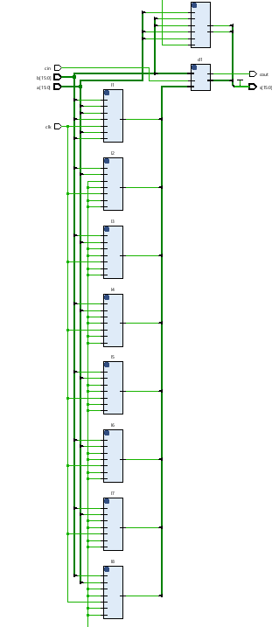
RTL Schematic of APEX

Slide 21
Schematic results of APEX

Slide 22
Future scope
In the future the proposed adders can be designed efficiently by establishing a trade-off between error and parameters like area, delay and power by making efficient ways in carry chain or accurate adders etc. and as an application it can also be implemented in multiplier architectures at the partial product reduction process thereby improving the efficiency of the design.

Slide 23
References
[1] G. A. Gillani, M. A. Hanif, B. Verstoep, S. H. Gerez, M. Shafique, and A. B. J. Kokkeler, ‘‘MACISH: Designing approximate MAC accelerators with internal-self-healing,’’ IEEE Access, vol. 7, pp. 77142–77160, 2019.
[2] E. Kalali and I. Hamzaoglu, ‘‘An approximate HEVC intra angular prediction hardware,’’ IEEE Access, vol. 8, pp. 2599–2607, 2020.
[3] T. Ayhan and M. Altun, ‘‘Circuit aware approximate system design with case studies in image processing and neural networks,’’ IEEE Access, vol. 7, pp. 4726–4734, 2019.
[4] W. Ahmad and I. Hamzaoglu, ‘‘An efficient approximate sum of absolute differences hardware for FPGAs,’’ in Proc. IEEE Int. Conf. Consum. Electron. (ICCE), Las Vegas, NV, USA, Jan. 2021, pp. 1–5.
[5] H. Jiang, C. Liu, L. Liu, F. Lombardi, and J. Han, ‘‘A review, classification, and comparative evaluation of approximate arithmetic circuits,’’ ACM J. Emerg. Technol. Comput. Syst., vol. 13, no. 4, pp. 1–34, Aug. 2017.

Slide 24


